Slide 1


Introduction
ACCESSDATA® FORENSICS
FILTERING THE CASE
Forensic Analysis
Incident Response
eDiscovery
Information Assurance

Slide 2
Module Objectives
Filtering Basics
Designing Filters
Managing Filters
Managing Shared Filters
Compound Filters
Global Filters
Tab Filters
Importing and Exporting

Slide 3
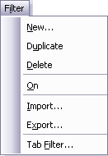
Filtering Basics
Filters are rule based
Create and then apply as needed
Can be shared for use in future cases
Can be exported and imported

Slide 4
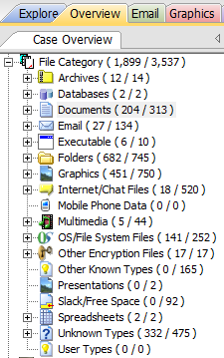
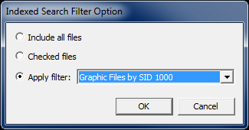
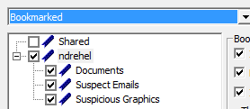
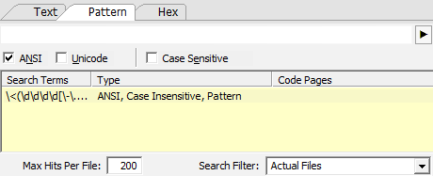
If You Build It…………
Filters can be designed and used for:
Quickly locating files of interest
Live Searching
Index Searching
Reports

Slide 5

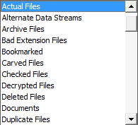
Global Filters
Filters applied to the toolbar are global across all the tabs
To activate a filter, select it from the drop-down menu

Slide 6

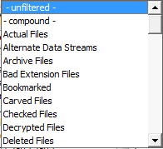

Global Filters
To deactivate a filter, select –unfiltered- from the drop-down list or click the Filter button
Filter Off
Filter On

Slide 7
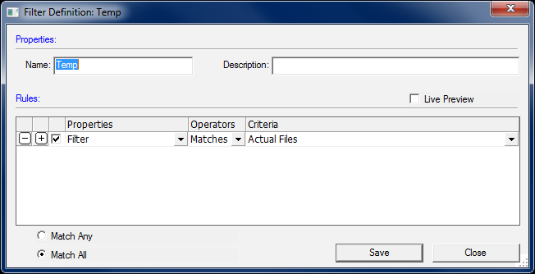
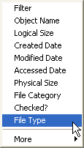

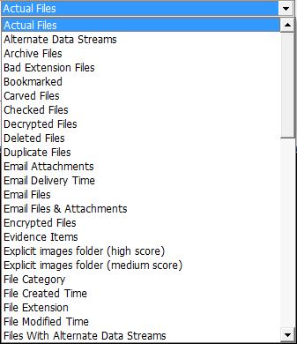
Creating a Filter

Slide 8
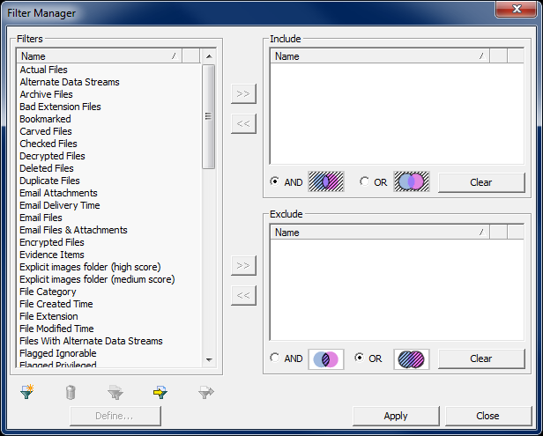
Creating a Filter

Slide 9
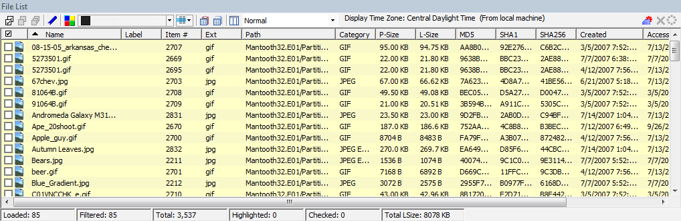
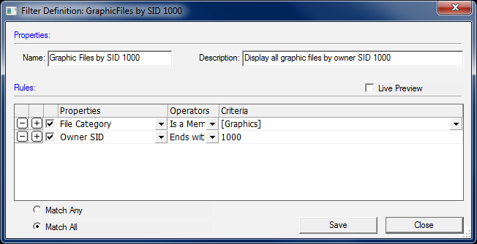
Adding Rules
Show only file category graphics
+
Match Owner SID ending in 1000
= Narrow Scope
+
Match All Rules

Slide 10
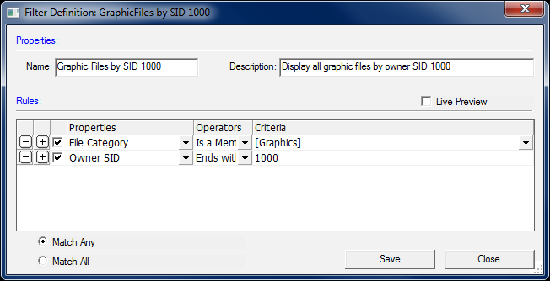
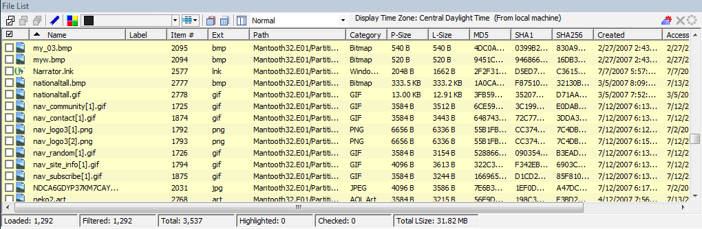
Adding Rules
Show only file category graphics
+
Show all files with Owner SID ending in 1000
= Broad Scope
+
Match Any Rule

Slide 11
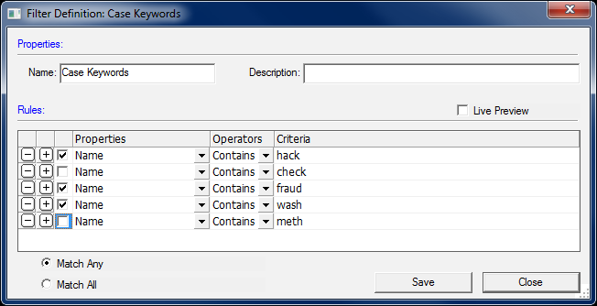
Adding Rules
Rules can be deactivated by unchecking them.

Slide 12
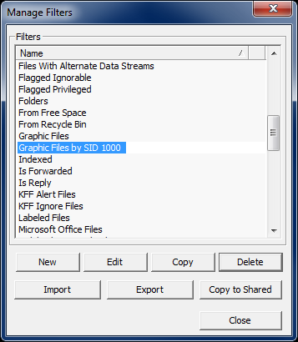
Managing Filters
New
Edit
Copy
Delete
Import
Export
Copy to Shared

Slide 13
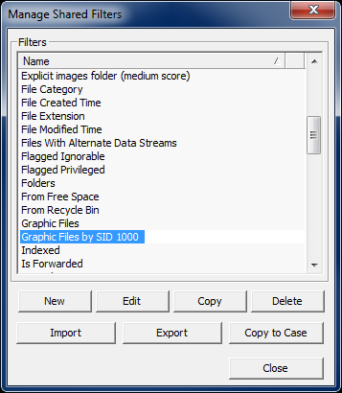
Managing Shared Filters
New
Edit
Copy
Delete
Import
Export
Copy to Case

Slide 14
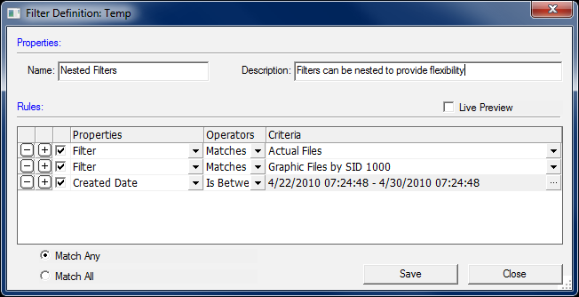
Nesting Filters
Filters can be nested for ultimate flexibility

Slide 15
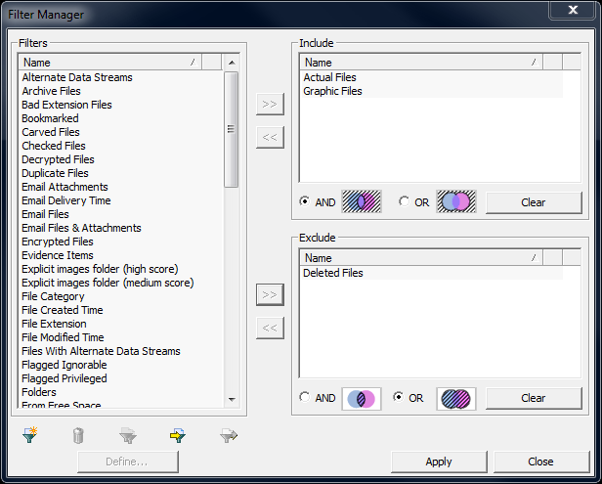
Compound Filters
Select and apply multiple filters at the same time

Slide 16
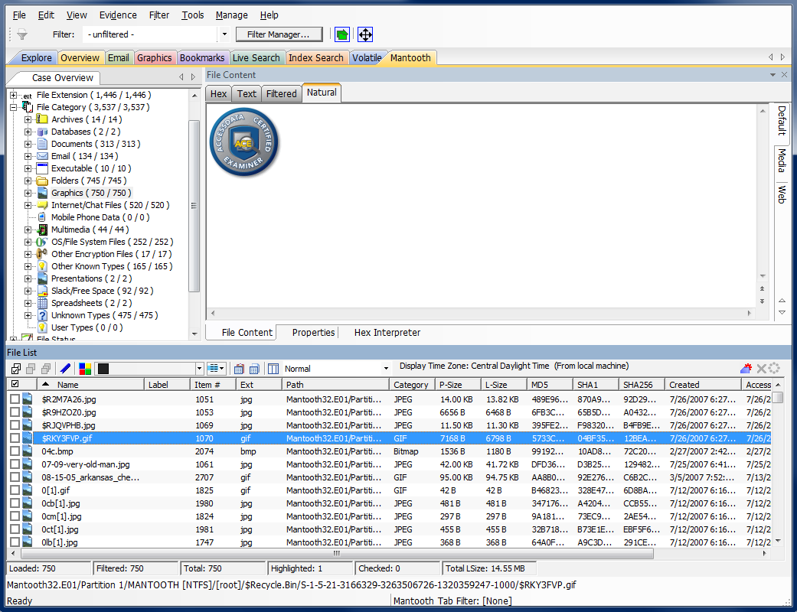
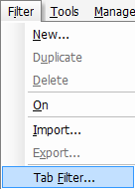
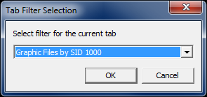
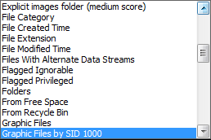
Tab Filters

Slide 17
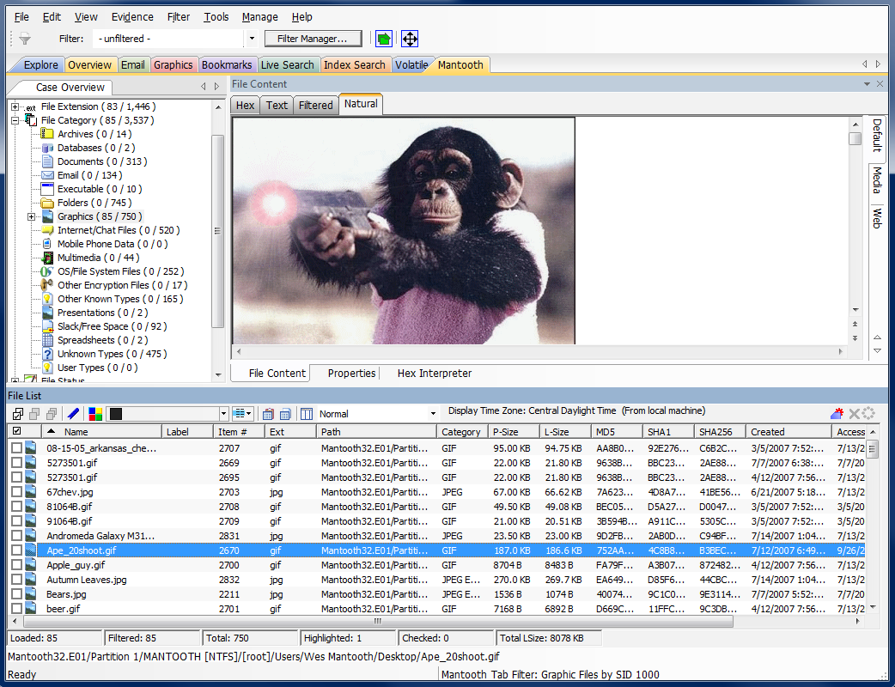
Tab Filters

Slide 18
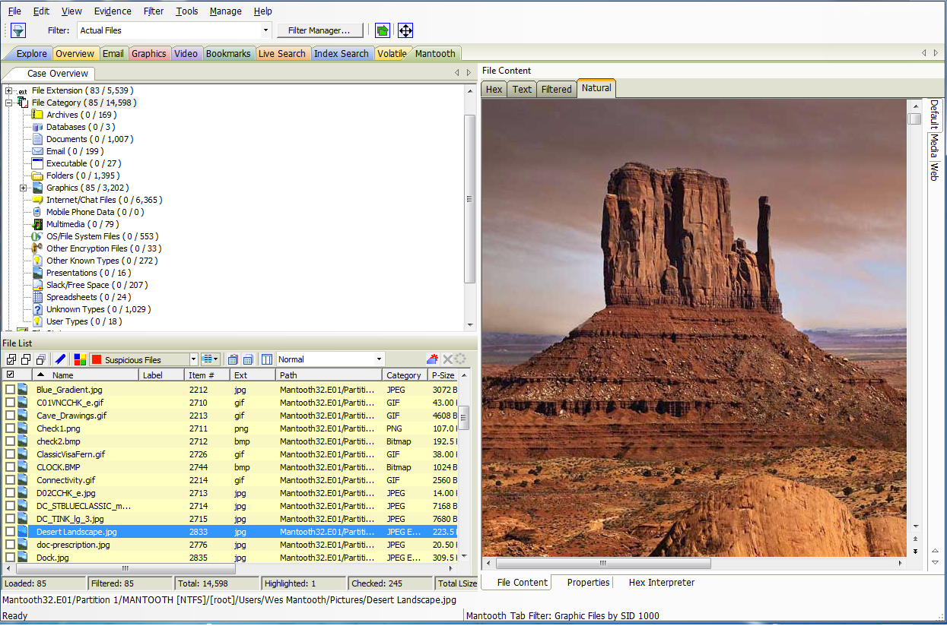
Using Filters Together
Tab filters can be used with global filters

Slide 19
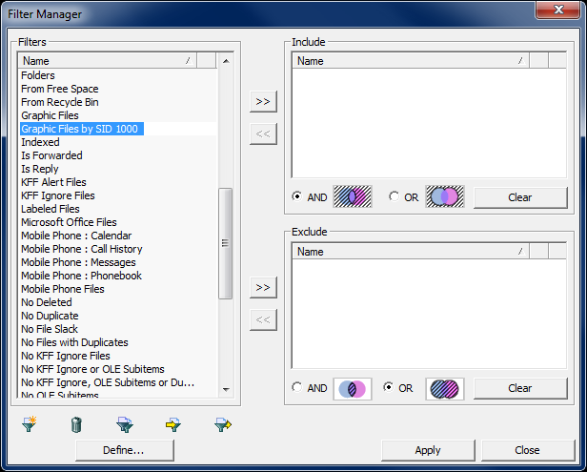
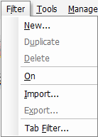
Importing and Exporting
XML Format

Slide 20
Module Review
Filtering Basics
Designing Filters
Managing Filters
Managing Shared Filters
Compound Filters
Global Filters
Tab Filters
Importing and Exporting

Slide 21



